Slide 1

TEAM NAME : HAMLET OF HACKERS
2. MEMBERS ‘S NAME : KAVEENA K - 9361087202
KEERTHANA S - 9698785660
MOUNA RANGEETHA V - 9361469391
SAHANAJ ANEEZ M - 6379675007
3. DOMAIN NAME : SMART VEHICLE
4. PROBLEM STATEMENT : TYRE LIFE PREDICTION SYSTEM

Slide 2
PROBLEM STATEMENT
The tyres are the most crucial part of every vehicle .The worn-out tyres have many risk factors involved. The tyre will deteriorate once it is exposed to the atmosphere. The age of the tyre is also one deciding factor of the tyre life other than that the high-speed operation and overloading also causes of irregular tyre wear. Currently, there is no automated system to identify the defects in a vehicle tyre and also to predict the tyre life. Due to this lot of accidents occurred in the recent past and very least people check the tyre condition before taking the vehicle. It's now a major concern to safeguard our life from such incidents. We developed an indigenous Automated system to check the tyre life.

Slide 3
ABSTRACT
At present life prediction of tyres involves penny test for tread depth and other defects by naked eye judgment.
The testing involves software to predict tyre life with one’s one hand instead of taking the vehicle to the garage and spending time to diagnose.
For automated defect identification, we use Convolutional Neural Network (CNN).
Our System is trained to identify common tyre defects and we provide recommendations based on the predicted results to improve the tyre life so that the user will be able to ensure safety at the same time.

Slide 4
NOVELTY
There is no existing software system for this project.
In our project we are developing an app to predict the life of tyre which gives more accuracy and it is more cost and time efficient.

Slide 5
TECHNOLOGY STACK
Python
Google Colab
Pip
Numpy
Flask
TensorFlow
Keas
Android Studio
Laptop
Heroku

Slide 6
SOFTWARE IMPLEMENTATION
The Tyre defect will be detected by the CNN model.
We have designed an algorithm that can get the inputs from the user through a mobile app.
The algorithm includes all the crucial parameters that affect the tyre life both mechanical and physical.
With the inputs from the user and the result from the prediction model our system can provide users with the result,

Slide 7
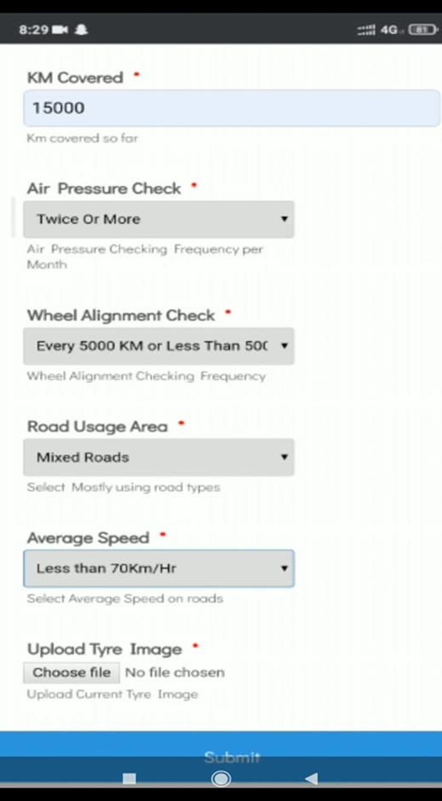
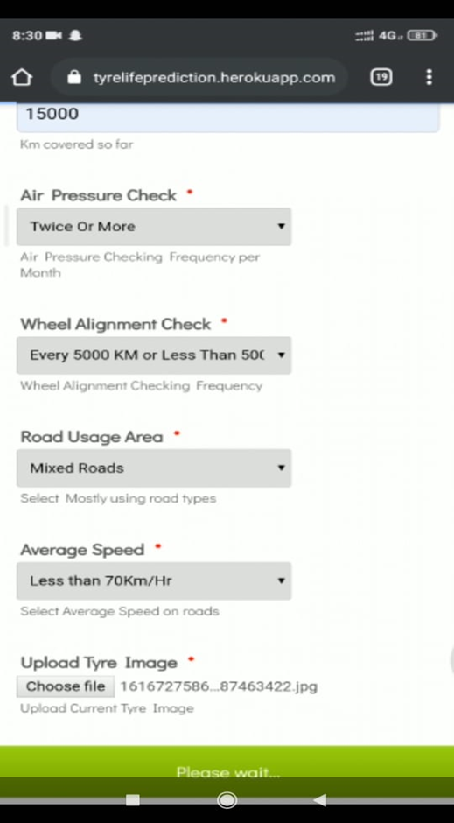
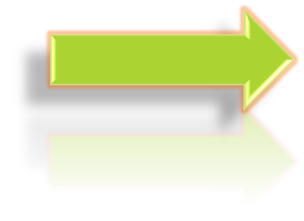
EXECUTION PLAN

Slide 8
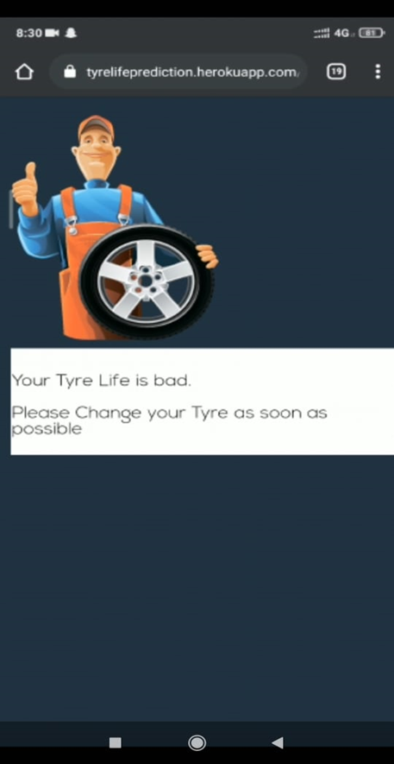
OUTPUT

